Slide 1
Eigenvalues and Eigenvectors
THE CHARACTERISTIC EQUATION

Slide 2
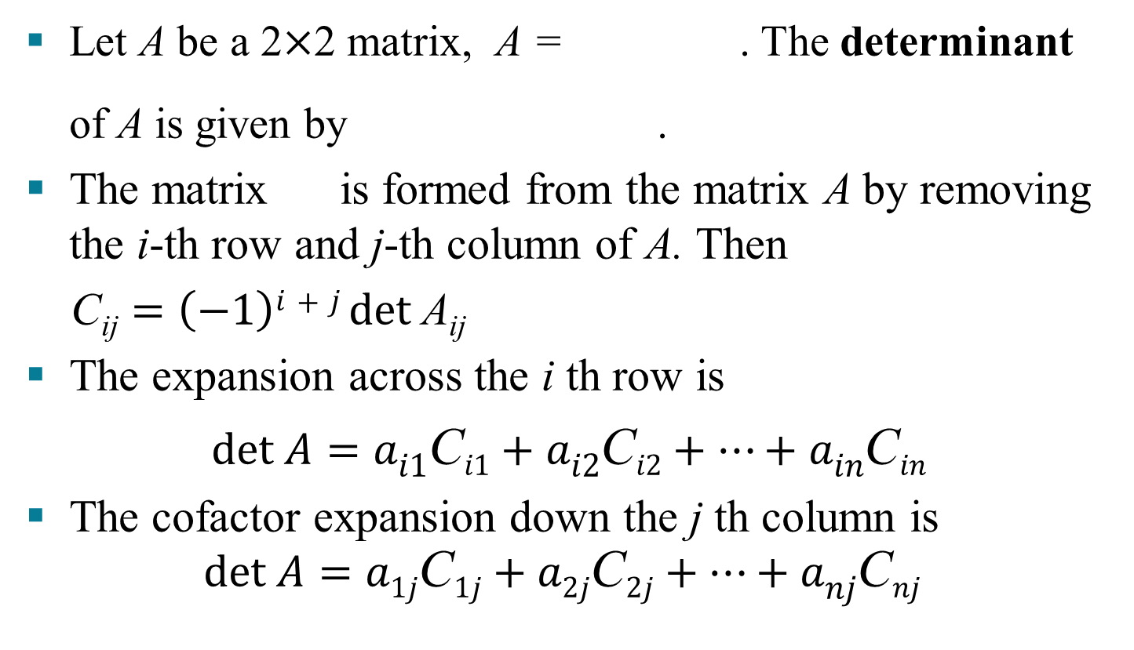
REVIEW OF DETERMINANTS
Let A be a 2$×$2 matrix, A = . The determinant
of A is given by .
The matrix is formed from the matrix A by removing the i-th row and j-th column of A. Then
$\text{C}\text{ij}=\left(−1\right)i+j det \text{A}\text{ij}$
The expansion across the i th row is
$det A=ai1\text{C}i1+ai2\text{C}i2+…+ain\text{C}in$
The cofactor expansion down the j th column is
$$det A=a1j\text{C}1j+a2j\text{C}2j+…+anj\text{C}nj$$

Slide 3
REVIEW OF DETERMINANTS
Theorem 3: Properties of Determinants
Let A and B be matrices.
A is invertible if and only if det .
.
.
If A is triangular, then det A is the product of the entries on the main diagonal

Slide 4
THE CHARACTERISTIC EQUATION
The scalar equation is called the characteristic equation of A.
A scalar λ is an eigenvalue of an matrix A if and only if λ satisfies the characteristic equation
Note that if and only if there is nonzero vector x in if and only if there is a nonzero vector x such that

Slide 5
THE CHARACTERISTIC EQUATION
Example 2: Find the characteristic equation of
Solution: Form , and use Theorem 3(d):

Slide 6
THE CHARACTERISTIC EQUATION
The characteristic equation is
or

Slide 7
THE CHARACTERISTIC EQUATION
Expanding the product, we can also write
The eigenvalue 5 in Example 2 is said to have multiplicity 2 because occurs two times as a factor of the characteristic polynomial.
In general, the (algebraic) multiplicity of an eigenvalue λ is its multiplicity as a root of the characteristic equation.

Slide 8
THE INVERTIBLE MATRIX THEOREM
Theorem: Let A be an matrix. Then A is invertible if and only if:
r. The number 0 is not an eigenvalue of A.
Proof:
A is not invertible
if and only if
if and only if
0 is an eigenvalue of A

Slide 9
SIMILARITY
If A and B are matrices, then A is similar to B if there is an invertible matrix P such that , or, equivalently, .
Writing Q for , we have .
So B is also similar to A, and we say simply that A and B are similar.
Changing A into is called a similarity transformation.

Slide 10
SIMILARITY
Theorem 4: If matrices A and B are similar, then they have the same characteristic polynomial and hence the same eigenvalues (with the same multiplicities).
Proof: If , then,
Using the multiplicative property (b) in Theorem (3), we compute
(1)

Slide 11
SIMILARITY
Since , we
see from equation (1) that .
Warnings:
The matrices
and
are not similar even though they have the same eigenvalues.

Slide 12
SIMILARITY
Similarity is not the same as row equivalence. (If A is row equivalent to B, then for some invertible matrix E ). Row operations on a matrix usually change its eigenvalues.

